Slide 1
SKIN DISEASE DETECTION USING IMAGE PROCESSING WITH SVM
PROJECT BY
I. Akash M (IV YR BE)
412516104017
II. Sricharan P(IV YR BE)
412516104140
GUIDED BY
MR.M.BALAMURUGAN M. Tech
Assistant Professor

Slide 2
ABSTRACT
Skin diseases are hazardous and often contagious, especially melanoma, eczema, and impetigo.
These skin diseases can be cured if detected early.
Sometimes, the doctors also fail to correctly classify the disease.
Our system proposes a skin disease detection method based on Image Processing and Machine Learning Techniques.

Slide 3
The patient needs to provide the image of the infected area and it is given as an input to the application.
Our application uses machine learning techniques to classify the skin disease.

Slide 4
OBJECTIVE
To Develop Machine learning application that in general, has the ability to determine the affected areas in the image and to determine the disease in the specified region.

Slide 5
LITERATURE SURVEY
NAME OF THE AUTHOR | YEAR | NAME OF THE JOURNAL | WORK CARRIED OUT | ALGORITHM/DRAWBACK
. T. K. Munia, M. N. Alam, J. Neubert, and R. Fazel-Rezai | 2017 | Automatic diagnosis of melanoma using linear and nonlinear features from digital image | Pre-processing ,segmentation, feature extraction ,melanoma classification, melanoma validation | Accuracy of the disease is lesser
V. Pomponiu, H. Nejati, and N.-M. Cheung | 2016 | Deepmole: Deep neural networks for skin mole lesion classification | Skin disease, texture based feature extraction. | More complexity in the algorithm

Slide 6
LITERATURE SURVEY
NAME OF THE AUTHOR | YEAR | NAME OF THE JOURNAL | WORK CARRIED OUT | ALGORITHM/DRAWBACK
A. Esteva, B. Kuprel, R. A. Novoa, J. Ko, S. M. Swetter, H. M. Blau,and S. Thrun | 2017 | Dermatologist-level classification of skin cancer with deep neural networks | Dermatology,image Processing,Machine Learning | It does not consider the different symptoms caused by the same kind of skin disease
M. H. Jafari, E. Nasr-Esfahani, N. Karimi, S. M. R. Soroushmehr,S. Samavi, and K. Najarian | 2017 | Extraction of skin lesions from non-dermoscopic images for surgical excision of melanoma | Skin disease, texture based feature extraction. | classification system performance reduces due to the effect of some classes, thereby affecting the overall performance of the system

Slide 7
LITERATURE SURVEY
NAME OF THE AUTHOR | YEAR | NAME OF THE JOURNAL | WORK CARRIED OUT | ALGORITHM/DRAWBACK
M. Emre Celebi, Q. Wen, S. Hwang, H. Iyatomi, and G. Schaefer | 2013 | Lesion border detection in dermoscopy images using ensembles of thresholding methods | Image acquisition, preprocessing,segmentation, feature extraction, post processing, classification | Accuracy of the disease is lesser

Slide 8
EXISTING SYSTEM
Utilized computer aided diagnosis for the purpose of segmentation of the skin lesions of images obtained from dermoscopy.
The methodology utilized for this was thresholding it automatically, using K- means, shifting by mean , growth regionally and Gradient Vector Flow (GVF).

Slide 9
PROPOSED SYSTEM
The proposed work shows the improvement in identifying the melanoma skin cancer at different stages using image processing techniques based on active contour segmentation, Local binary Pattern and SVM classifier.
The prime concern of the proposed work is to extract the skin image features i.e. area, perimeter and mean (R), mean (G), mean (B) and texture features.

Slide 10
HARDWARE REQUIREMENTS
Hard disk: 90GB and above
Processor: Pentium IV 2.4GHz and above
System type: 32bit / 64 bit
RAM: 2GB and above
OS: Windows 7/8/8.1/10

Slide 11
SOFTWARE REQUIREMENTS
Tool : MATLAB 2019a
Tool box : Image Processing Tool Box

Slide 12
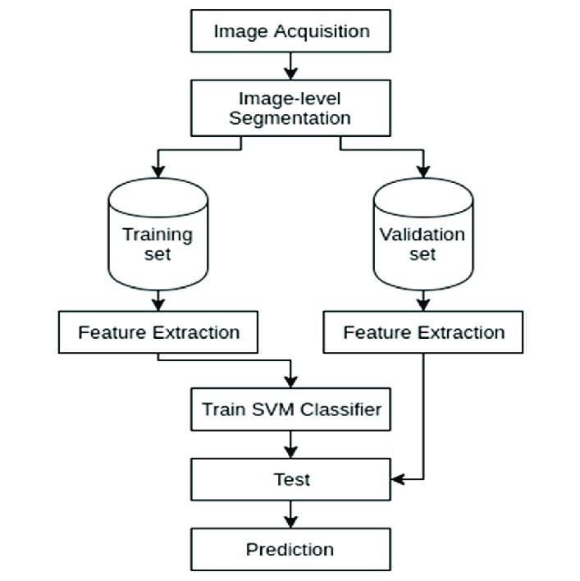
SYSTEM ARCHITECTURE

Slide 13
MODULES
Train Database
Pre-Processing
Segmentation
Classification

Slide 14
MODULE DESCRIPTION
TRAIN DATABASE:
For the training of our system, several images for each of our diseases were collected. Most of the images were downloaded from several websites and the database has been trained effectively.

Slide 15
PRE-PROCESSING
Before using the images to train our model, series of preprocessing have been applied to our data to enhance the images also to increase our data for better generalization. All these processes were implemented using MATLAB image processing toolbox.

Slide 16
SEGMENTATION
Image segmentation is performed to separate suspicious lesion from normal skin. This is implemented through MATLAB.

Slide 17
CLASSIFICATION
This task is to load a pre-trained model and use it to classify the input data into a suitable class of skin diseases, this function is the main function of the application.

Slide 18
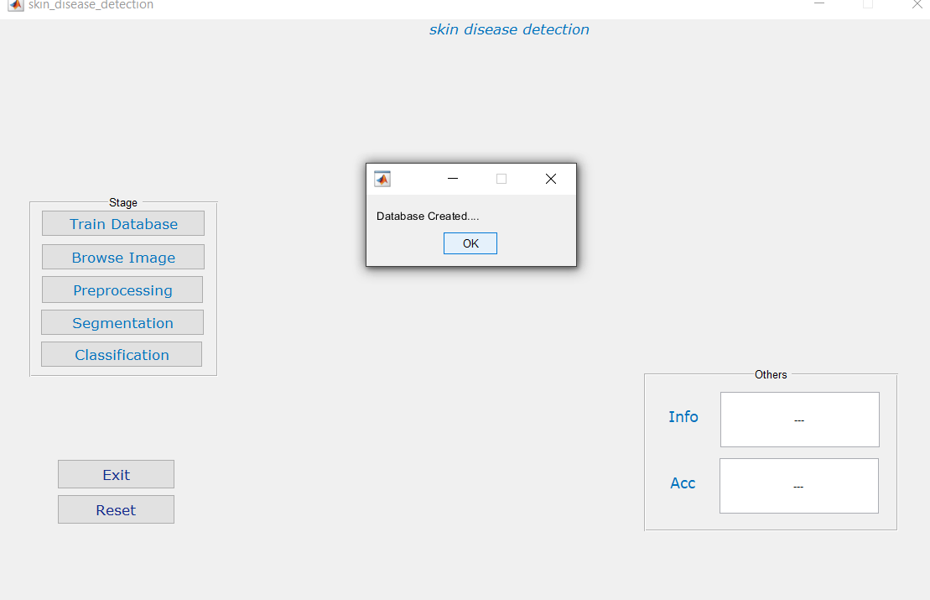
SNAPSHOTS

Slide 19
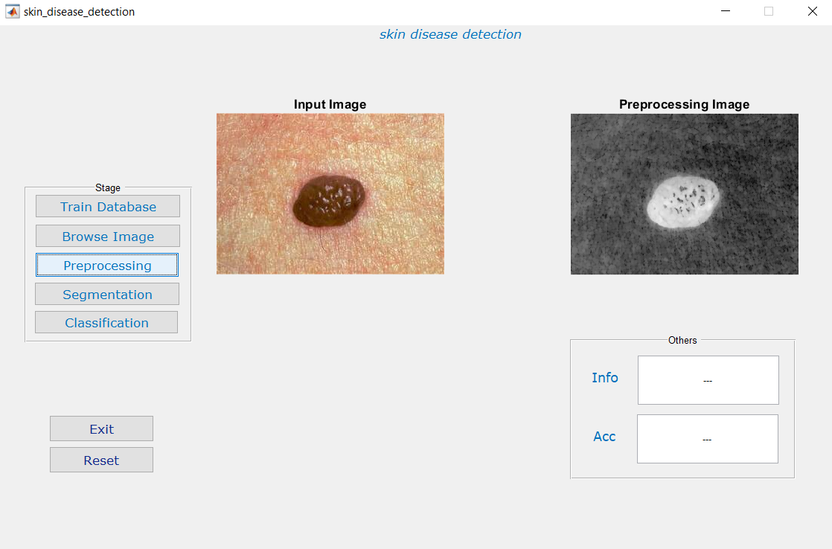
PRE-PROCESSING MODULE

Slide 20
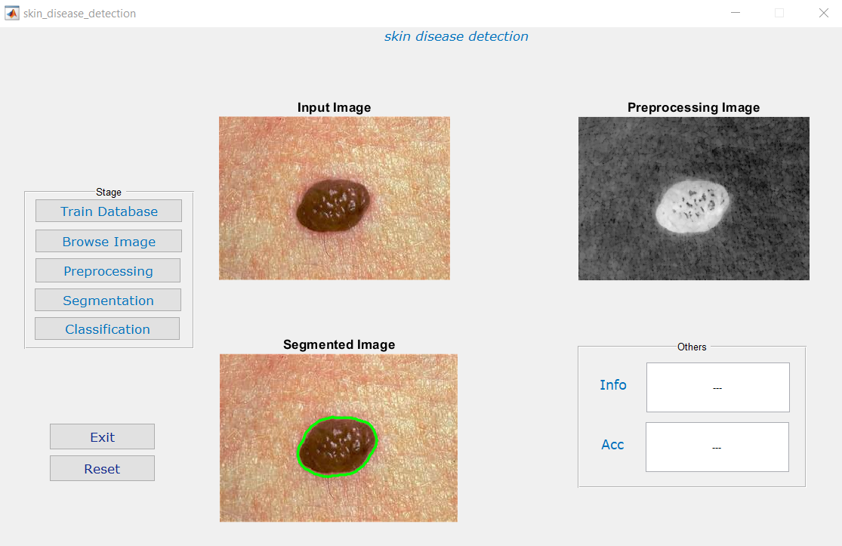
SEGMENTATION MODULE

Slide 21
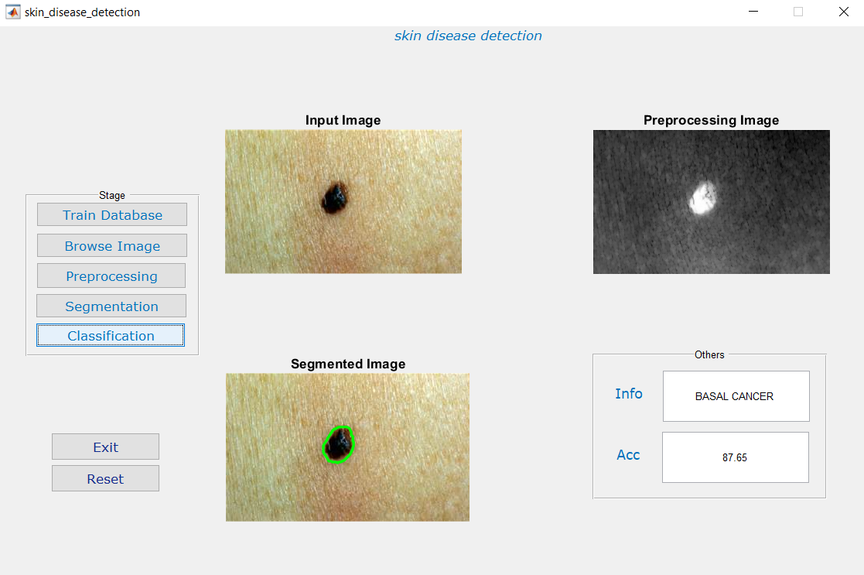
CLASSIFICATION MODULE

Slide 22
REFERENCE
[1] T. T. K. Munia, M. N. Alam, J. Neubert, and R. Fazel-Rezai, “Automatic diagnosis of melanoma using linear and nonlinear features from digital image,” in 2017 39th Annual International Conference of the IEEE Engineering in Medicine and Biology Society (EMBC), July 2017.
[2] V. Pomponiu, H. Nejati, and N.-M. Cheung, “Deepmole: Deep neural networks for skin mole lesion classification,” in IEEE International Conference on Image Processing (ICIP). IEEE, 2016.
[3] A. Esteva, B. Kuprel, R. A. Novoa, J. Ko, S. M. Swetter, H. M. Blau,and S. Thrun, “Dermatologist-level classification of skin cancer with deep neural networks,” Nature, vol. 542, 2017.

Slide 23
[4] M. H. Jafari, E. Nasr-Esfahani, N. Karimi, S. M. R. Soroushmehr,S. Samavi, and K. Najarian, “Extraction of skin lesions from non-dermoscopic images for surgical excision of melanoma,” International Journal of Computer Assisted Radiology and Surgery, vol. 12, no. 6, pp. 1021–1030, Jun 2017.
[5] M. Emre Celebi, Q. Wen, S. Hwang, H. Iyatomi, and G. Schaefer,“Lesion border detection in dermoscopy images using ensembles of thresholding methods,” Skin Research and Technology, vol. 19, no. 1, pp. 252–258, 2013.

Slide 24
CONCLUSION
Difficulties in the diagnosing skin diseases arise because of the spreading of the skin diseases all over the world.
A computer aided system is proposed to resolve these difficulties, so a machine learning model is designed with algorithm which uses SVM as a classifier .
The developed system performs the required work with accuracy 94% within the dataset and 85% with the external data, and the integrated system is working properly.

Slide 25
THANK YOU!!!

